Slide 1
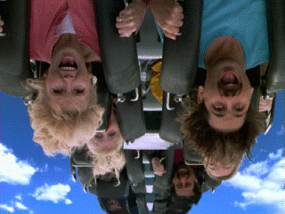
Circular Motion
Vertical

Slide 2
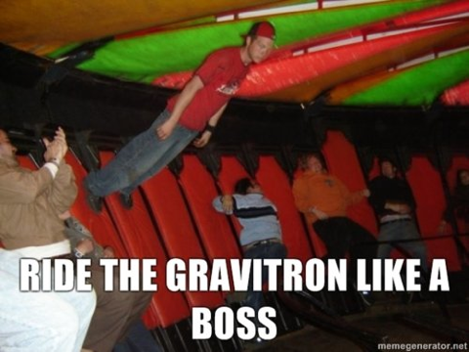
Review Question:
How is this guy like the stopper in your experiment?
What would happen if the Gravitron spun in a vertical circle of very high velocity?

Slide 3
Motion in a Vertical Circle
The most important thing to note about ANY form of circular motion is that the SUM of ALL FORCES must equal the Centripetal Force.
∑F = F_{c}
Note also that the positive direction is always along acceleration, i.e., toward the center of the circle.

Slide 4
Motion in a Vertical Circle
v
v
Consider the forces on a ball attached to a string as it moves in a vertical loop.
v
v
+
Bottom
mg
T
+
T
T
T
+
mg
+
+
mg
mg
T
T
Note also that the positive direction is always along line of centripetal acceleration, i.e., toward the center of the circle.
v
v
Top of Path
Left Side
mg
mg
Top Right
Top Right
+
Tension is minimum as weight helps F_{c} force
Weight has no effect on T
Maximum tension T, W opposes F_{c}
Weight causes small decrease in tension T
Weight has no effect on T
Bottom

Slide 5
As an exercise, assume that a centripetal force of F_{c} = 40 N is required to maintain circular motion of a ball and W = 10 N.
v
+
10 N
T
r
T
+
v
The tension T must adjust so that centripetal resultant is 40 N.
10 N
At top: 10 N + T = 40 N
T = _?_
T = 30 N
Bottom: T – 10 N = 40 N
T = 50 N
T = __?___

Slide 6
v
mv²
r
Resultant force toward center
F_{c} =
mg
T
r
Consider TOP of circle:
v
mv²
r
AT TOP:
mg + T =
+
mg
mv²
r
T = - mg
T

Slide 7
Vertical Circle; Mass at bottom
v
Resultant force toward center
mv²
r
F_{c} =
r
T
Consider bottom of circle:
v
mv²
r
mg
T - mg =
AT Bottom:
T
mv²
r
+
T = + mg
mg

Slide 8
Example: Assume that the centripetal force required to maintain circular motion is 20 N. and that the weight is 5 N.
v
r
Resultant centripetal force F_{C} at every point in path!
v
F_{C} = 20 N
Weight vector W is downward at every point.
F_{C} = 20 N at top AND at bottom.
W = 5 N, down

Slide 9
Visual Aid: The resultant force (20 N) is the vector sum of T and W at ANY point in path.
v
Top: T + W = F_{C}
WT
+
T + 5 N = 20 N
r
T = 20 N - 5 N = 15 N
T
W
+
Bottom:
v
T - W = F_{C}
F_{C} = 20 N at top AND at bottom.
T - 5 N = 20 N
T = 20 N + 5 N = 25 N

Slide 10
For Motion in Circle
v
AT TOP:
mv²
r
r
+
T = - mg
mg
T
v
AT BOTTOM:
T
mv²
r
+
T = + mg
mg

Slide 11
Example: A 2-kg rock swings in a vertical circle of radius 8 m. The speed of the rock as it passes its highest point is 10 m/s. What is tension T in rope?
mv²
r
At Top:
mg + T =
v
mg
mv²
r
T
r
T = - mg
v
T = 25 N - 19.6 N
T = 5.40 N

Slide 12
Example: A 2-kg rock swings in a vertical circle of radius 8 m. The speed of the rock as it passes its lowest point is 10 m/s. What is tension T in rope?
mv²
r
v
At Bottom:
T - mg =
mv²
r
r
T = + mg
T
v
mg
T = 44.6 N
T = 25 N + 19.6 N

Slide 13
Example: What is the minimum speed v_{c} at the top, if the 2-kg mass is to continue in a circle of radius 8 m?
0
mv²
r
v
At Top:
mg + T =
mg
T
r
v_{c} occurs when T = 0
mv²
r
v
mg =
v_{c} = gr
v = gR = (9.8 m/s²)(8 m)
v_{c} = 8.85 m/s

Slide 14
The Loop-the-Loop Same as cord, n replaces T
v
AT TOP:
mv²
r
+
n = - mg
r
mg
n
v
AT BOTTOM:
mv²
r
n= + mg
n
+
mg

Slide 15
The Ferris Wheel
v
mv²
r
AT TOP:
mg - n =
n
r
+
mv²
r
n = mg -
v
mg
AT BOTTOM:
mv²
r
n
n = + mg
+
mg

Slide 16
Example: What is the apparent weight of a 60-kg person as she moves through the highest point when r = 45 m and the speed at that point is 6 m/s?
n
v
+
mg
r
v
Apparent weight will be the normal force at the top:
mv²
r
mv²
r
mg - n =
n = mg -
n = 540 N

Slide 17
Summary: Motion in Circle
v
AT TOP:
mv²
r
+
T = - mg
r
mg
T
v
AT BOTTOM:
mv²
r
T
T = + mg
+
mg

Slide 18
Summary: Ferris Wheel
v
mv²
r
AT TOP:
mg - n =
n
r
+
mv²
r
n = mg -
v
mg
AT BOTTOM:
mv²
r
n
n = + mg
+
mg

Slide 19
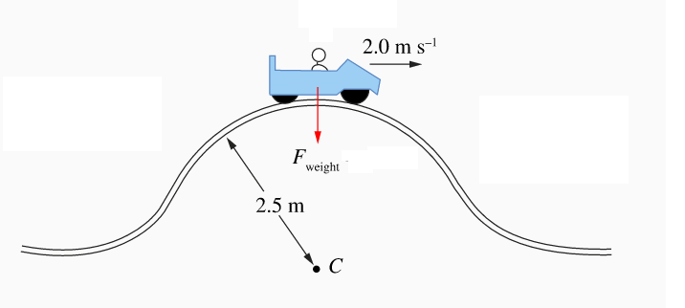
Textbook Example
What reaction force (normal) is provided on the 50 kg occupant of this roller coaster cart in circular motion over the crest of the track?

Slide 20
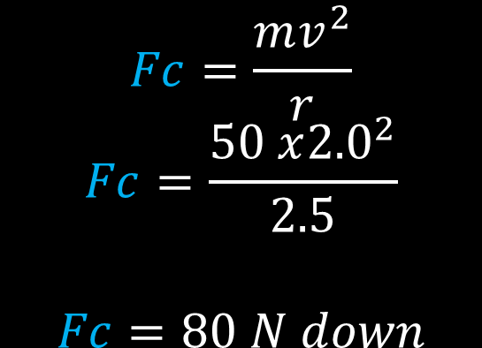
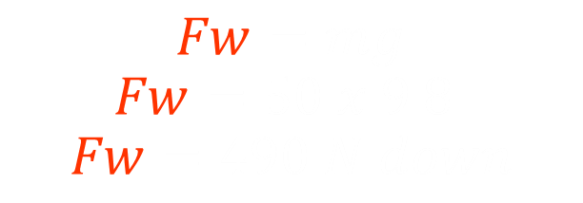
Textbook Example
∑F = F_{c}
F_{c}= F_{w} + F_{n}
$$Fc=\frac{mv^{2}}{r}$$
$$Fc=\frac{50 x{2.0}^{2}}{2.5}$$
$$Fc=80 N down$$
$$Fw=mg$$
$$Fw=50 x 9.8$$
$$Fw=490 N down$$
F_{c}= F_{w} + F_{n}
80 = 490 + Fn
Fn = - 410 N
i.e. Fn = 410 N UP

Slide 21
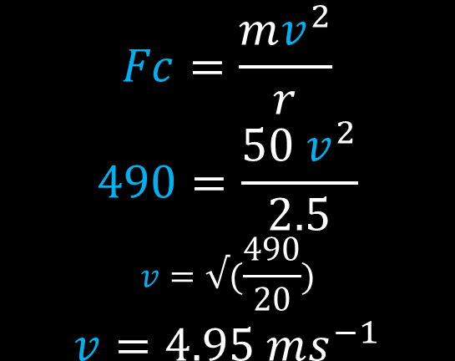
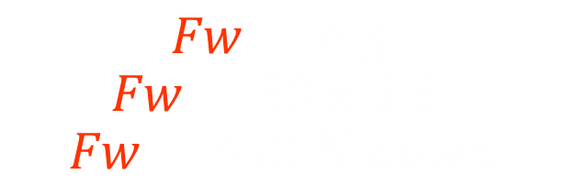
Textbook Example
At what speed would the rider experience apparent weightlessness?
Apparent weightlessness occurs when there is no reaction force on the body for us to feel as weight.
F_{c}= F_{w} + F_{n}
$$Fw=mg$$
$$Fw=50 x 9.8$$
$$Fw=490 N down$$
$$Fc=\frac{mv^{2}}{r}$$
$$490=\frac{50 v^{2}}{2.5}$$
$$v=√(\frac{490}{20})$$
$$v=4.95 ms^{−1}$$
F_{c}= F_{w}
F_{c} = 490 N

Slide 22
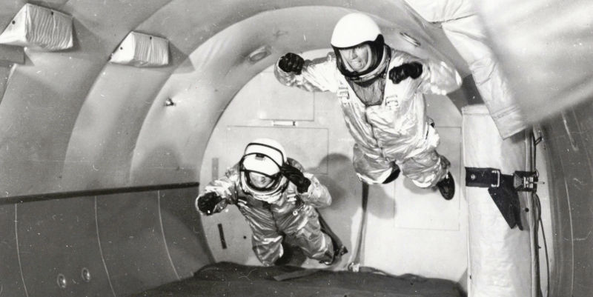
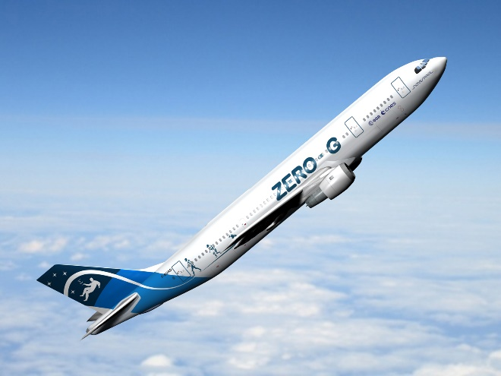
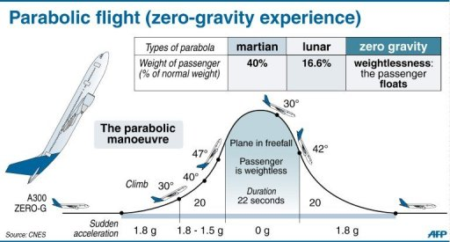
Zero G

Slide 23
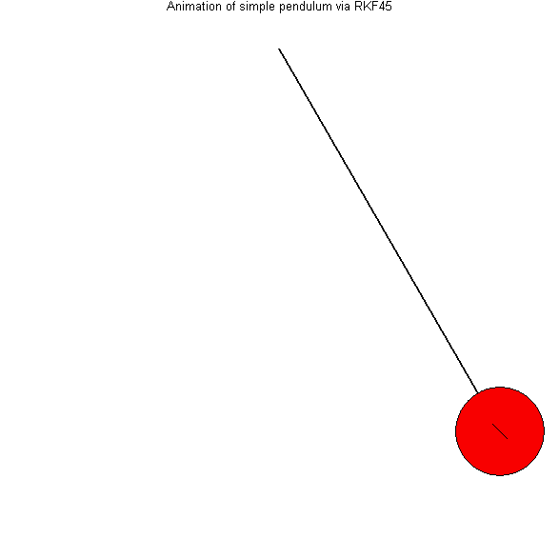
Pendulums and Non Uniform Circular Motion
A pendulum is an example of non uniform circular motion.
The mass swings through a circular arc but its speed changes due to potential to kinetic energy conversions.
Because the speed is not constant, the required centripetal force also changes.
This means that the tension varies as well.
Q. What other reason is there that the tension might vary depending on position in the arc?

Slide 24
Pendulums and Non Uniform Circular Motion
Pendulum calculations require use of PE to KE conversion calculations to work out speed..
i.e. PE lost = KE gained
mgh = ½ mv²
gh = ½ v²
v = √2gh
Speed can then be used in a Centripetal Force Calculation

Slide 25

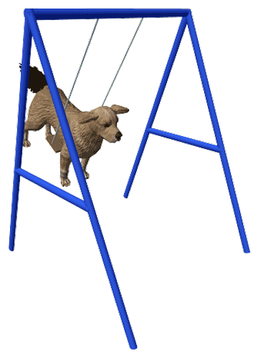
Pendulums and Non Uniform Circular Motion
Mr Carter’s dog “Tess” enjoys playing on the swing when she goes “walkies” down to the park.
If Tess has a mass of 35.0 kg and swings to a height of 1.65 m above her lowest position at the end of 2.50m chains.
Where is the tension in the chains the greatest?
What is the tension in each cable at this point?

